Slide 1
Community Manager Think Tank Blogger Outreach
Phil Gomes
Senior Vice President
Edelman Digital

Slide 2
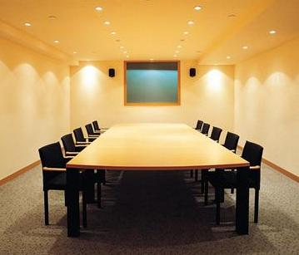
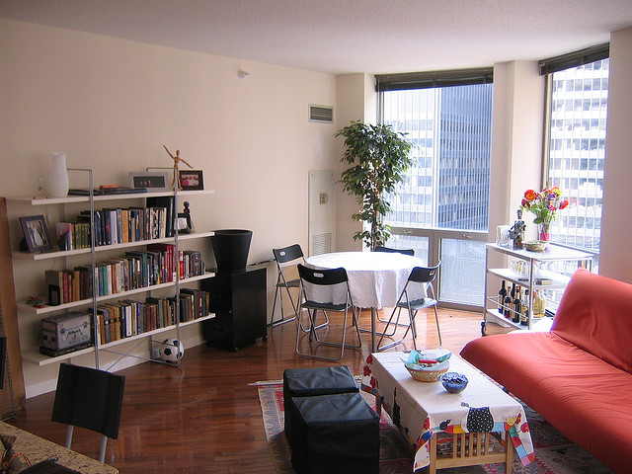

Slide 3
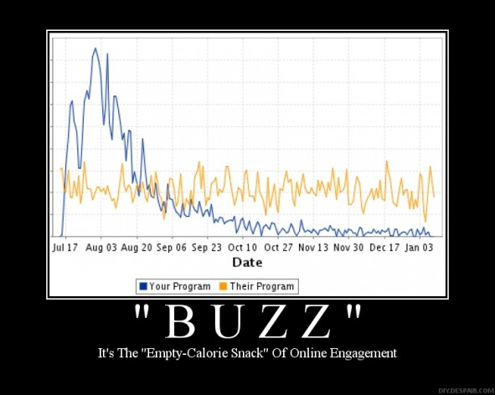

Slide 4
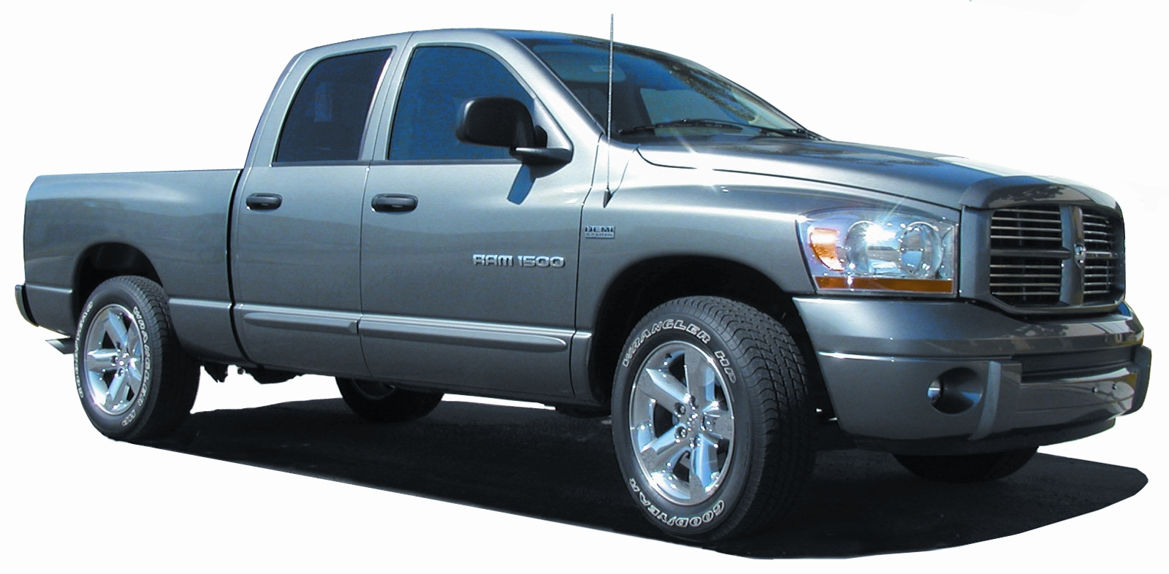

Slide 5
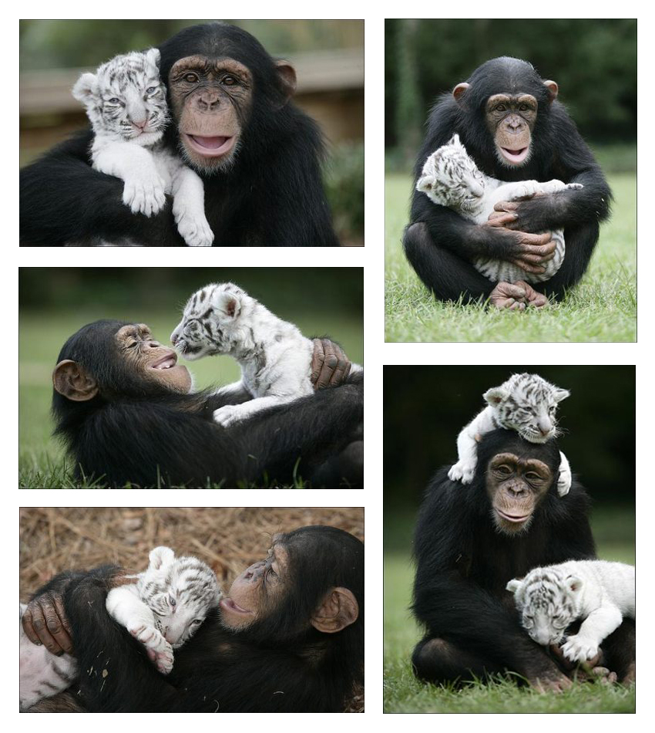

Slide 6
Access > Free Stuff

Slide 8
Community Manager Think Tank Blogger Outreach
Phil Gomes
Senior Vice President
Edelman Digital

